Slide 1

To do list
Micro it
Diya saini

Slide 2

INTRODUCTION
A To-Do List project is a tool for organizing and managing tasks, promoting productivity by allowing users to prioritize, track progress, and visualize their workload. It can be a simple list, a spreadsheet, or a more complex application with features like task management, sorting, and filtering. The core benefit is to help individuals and teams stay on track and achieve their goals by breaking them down into manageable steps
.

Slide 3
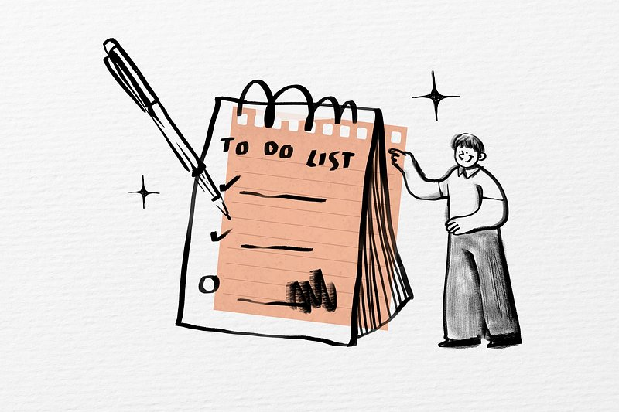
OBJECTIVE
The primary objective of a to-do list project in programming is to create a tool that helps users manage their tasks effectively by providing functionality to add, edit, delete, and mark tasks as completed. The project aims to enhance productivity and organization by providing a simple and user-friendly way to track and complete tasks.
Task Management
Prioritization and Organization
Progress Tracking
Increased Productivity
User-Friendly Interface

Slide 4
SYSTEM DESIGN
DATA MODEL
SYSTEM
ARCHITECTURE
DATA STORAGE
Simple File: Store tasks as a list or dictionary in a text file(e.g., tasks.txt).
Database: Use a database (e.g., SQLite) for more structured data and persistent storage.
Tasks: Each task would have attributes like description, due date, priority, and completion status
Lists: Tasks can be grouped into lists (e.g., "work," "personal," )
Modular Design: Break down the application into smaller, reusable modules or classes
Design patterns: Consider using design patterns like the command pattern for task

Slide 5

To Do List in Python
We are going to implement a simple python to-do list in which we can add a task and delete it when it’s done. We will be using a Python package called Tkinter which is a widely used Python GUI library. It is shipped with python, so we do not have to download or install it separately, we can just import and start with it.
A GUI is basically a medium to interact and present information to the users. One of the major advantages of using Tkinter is that it works well on any machine be it windows, linux, or macOS

Slide 6
Project Prerequisites To work on to do list in python, basic understanding of python programming language and Tkinter, especially Tkinter widgets would be helpful. But don’t worry as this article will provide an explanation of every line of code as we go about building this python project. You are free to choose any IDE of your choice (Pycharm, VSCode, etc.).
Steps to develop To-do List Project
Import the Tkinter library
Create to-do list application window
Create application layout
Define to do list functions

Slide 7

KEY COMPONENTS
Task Management Functions:
Add Task: Takes a task description as input and adds it to the task list.
View Tasks: Displays the list of tasks, possibly with formatting to show completion status or due dates.
Mark as Complete: Allows the user to select a task and mark it as completed. This could involve changing a status attribute or removing the task from the active list.
Delete Task: Removes a task from the list.
Edit Task: Modifies the description or other attributes of a task.
Error Handling:
Handling invalid user input, such as non-numeric choices or incorrect data formats.
Data Storage:
A list or other data structure (like a dictionary) to store tasks. Each task can be a string or a more complex object with attributes like description, due date, and completion status.

Slide 8

CODE STRUCTURE
OUTPUT
def main():
while True:
print("\nTo-Do List Menu:")
print("1. Show Tasks")
print("2. Add Task")
print("3. Remove Task")
print("4. Exit")
choice = input("Enter your choice: ").strip()
if choice == '1':
show_tasks()
elif choice == '2':
task = input("Enter the task to add: ").strip()
if task:
add_task(task)
else:
print("Task cannot be empty.")
elif choice == '3':
task = input("Enter the task to remove: ")
===== To-Do List =====
1. Add Task
2. Show Tasks
3. Mark Task as Done
4. Exit
Enter your choice: 1
How many tasks you want to add: 2
Enter the task: Complete micro it project
Enter the task: Attend function
Task added!
Task added!
Enter your choice: 2
Tasks:
1. Complete micro it project - Done
2. Attend function - Not Done

Slide 9
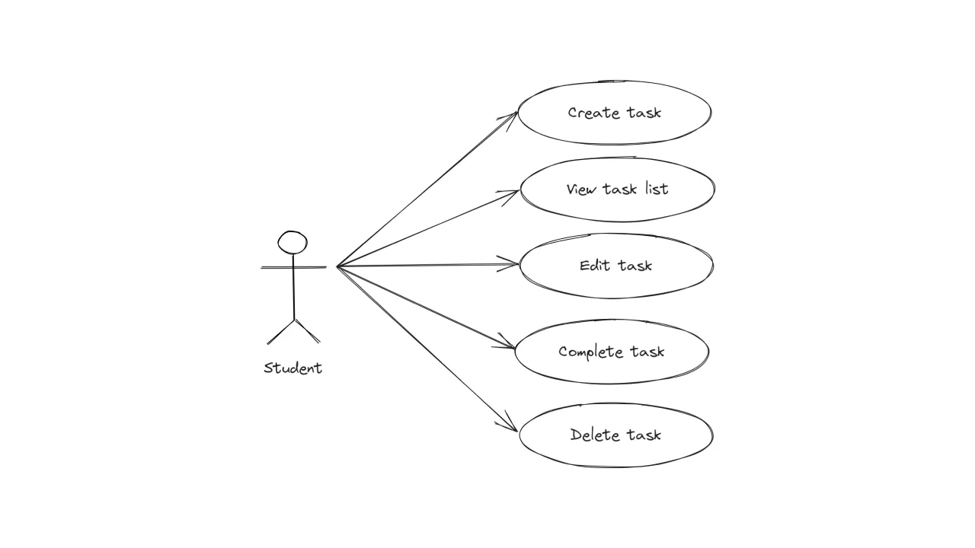
LEARNING OUTCOMES
This internship project taught me:
How to structure and manage a small-to-medium scale software project.
The importance of clean code and modular programming.
Hands-on experience in creating user-friendly interfaces.
Basics of software testing and debugging.
Effective use of version control systems

Slide 10
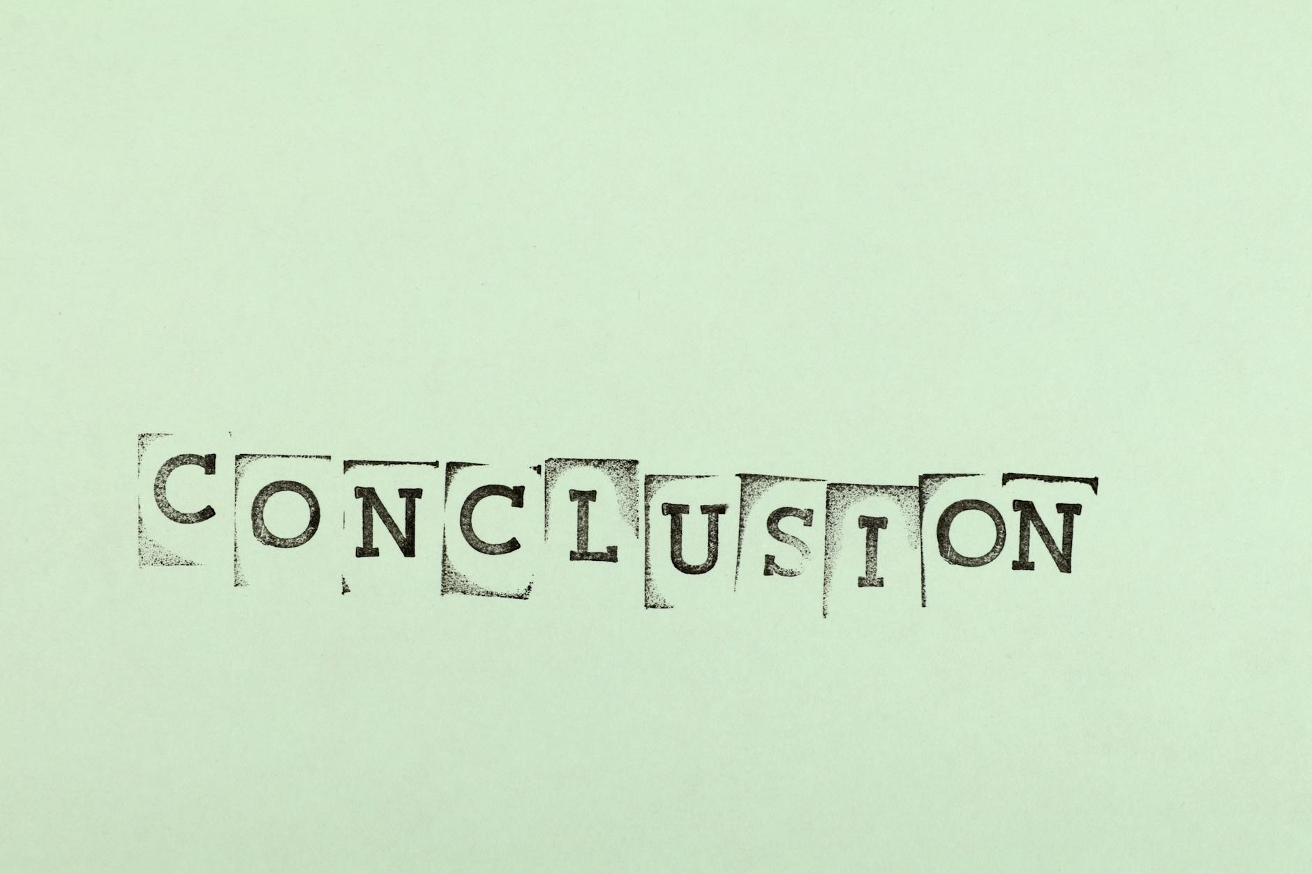
CONCLUSION
The project not only reinforces fundamental Python skills but also lays the groundwork for more advanced functionalities, such as data persistence, user authentication, and graphical user interfaces. These enhancements could transform the application into a more robust and user-friendly task management solution.
In conclusion, this To-Do List application serves as a valuable learning experience, illustrating the process of building functional software and offering a foundation for future development in Python programming
This project successfully demonstrates the development of a command-line To-Do List application using Python, emphasizing core programming concepts such as functions, data structures, and user input handling. By implementing features like adding, viewing, and removing tasks, the application provides a practical tool for task management.

Slide 11
FUTURE SCOPE
Some possible enhancements include:
1. AI-Powered Task Management
Integrating Artificial Intelligence can transform your application into a smart assistant
2. Voice-Controlled Interfaces
Incorporating voice recognition allows users to manage tasks hands-free, making the application more accessible and convenient.
3. Customizable and No-Code Features
Implementing drag-and-drop interfaces and customizable dashboards allows users to tailor the application to their specific needs without requiring coding skillsl
4. Cross-Platform Accessibility
Ensuring the application is accessible on various devices—such as smartphones, tablets, and desktops—facilitates task management on the go.

Slide 12
Thank You

